Slide 1
CSE 417T Introduction to Machine Learning
Lecture 10 Instructor: Chien-Ju (CJ) Ho

Slide 2
Logistics
Homework 2: due on Oct 7 (Friday)
Exam 1: October 27 (Thursday)
Topics: LFD Chapters 1 to 5
Timed exam (75 min) during lecture time
Location TBD
Closed-book exam with 2 letter-size cheat sheets allowed (4 pages in total)
No format limitations (it can be typed, written, or a combination)
Homework 3 will be posted some time next week
Expected due: Mar 5 (Saturday)

Slide 3
Recap

Slide 4
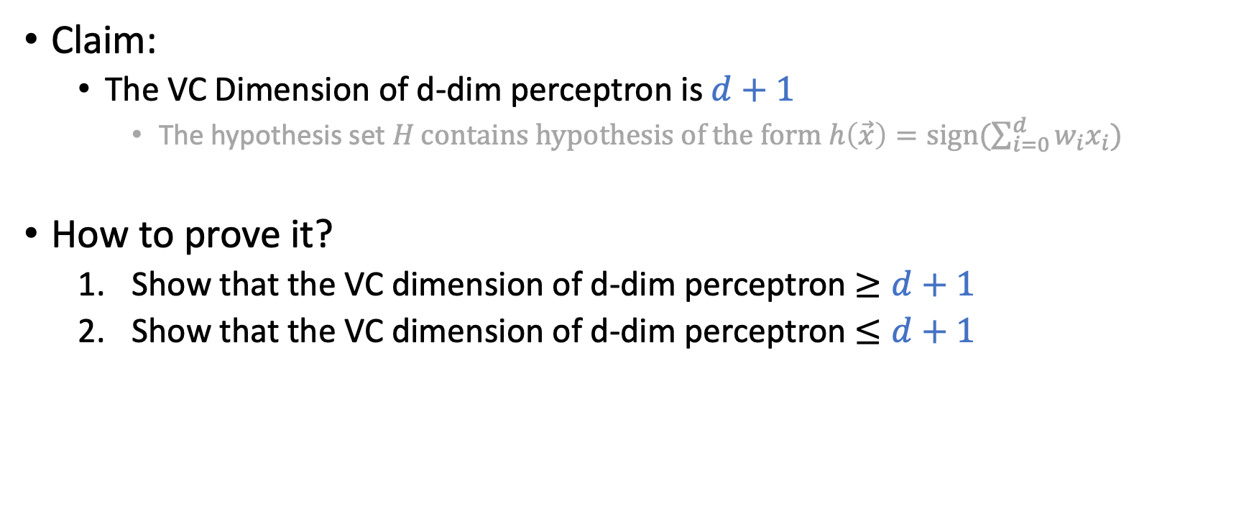
VC Dimension of d-dimension Perceptron
Claim:
The VC Dimension of d-dim perceptron is $d+1$
The hypothesis set $H \text{contains} \text{hypothesis} \text{of} \text{the} \text{form} h\left(\vec{x}\right)=\text{sign}(\sum_{i=0}^{d}{w_{i}x_{i}})$
How to prove it?
Show that the VC dimension of d-dim perceptron $≥d+1$
Show that the VC dimension of d-dim perceptron $≤d+1$

Slide 5
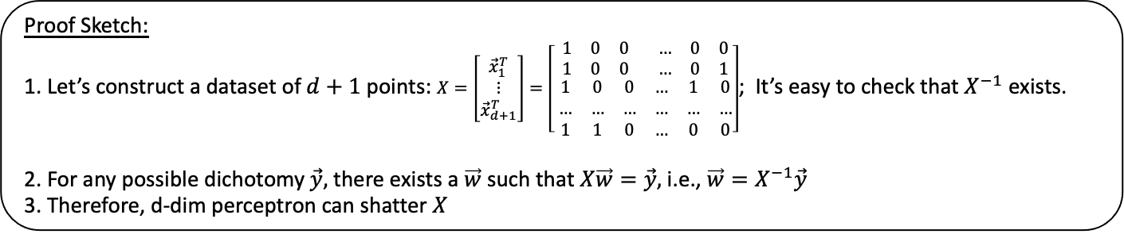
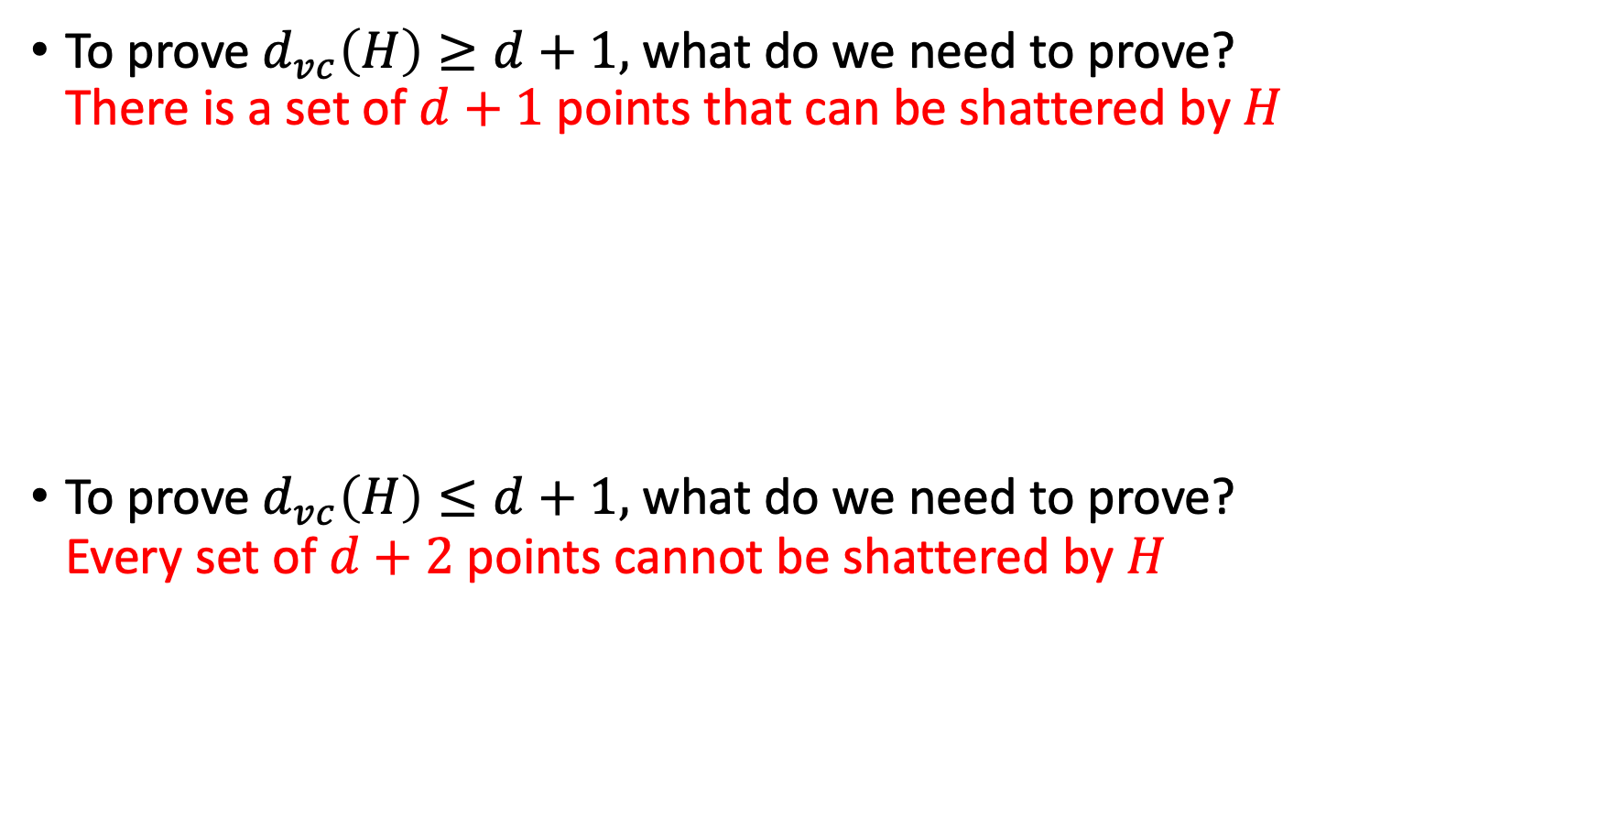
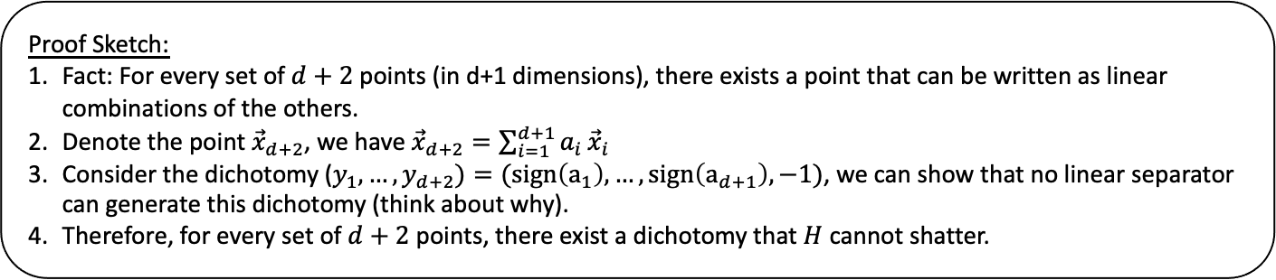
To prove $d_{vc}\left(H\right)≥d+1,$ what do we need to prove? There is a set of $d+1$points that can be shattered by $H$
To prove $d_{vc}\left(H\right)≤d+1,$ what do we need to prove? Every set of $d+2$ points cannot be shattered by $H$
Proof Sketch:
1. Let’s construct a dataset of $d+1$ points: $X=\left[\begin{matrix}{\vec{x}}_{1}^{T} \\ ⋮ \\ {\vec{x}}_{d+1}^{T}\end{matrix}\right]=\left[\begin{matrix}\begin{matrix}1 & 0 & 0 \\ 1 & 0 & 0\end{matrix} & \begin{matrix}… & 0 & 0 \\ … & 0 & 1\end{matrix} \\ \begin{matrix} 1 & 0 & 0 \\ … & … & … \\ 1 & 1 & 0\end{matrix} & \begin{matrix}… & 1 & 0 \\ … & … & … \\ … & 0 & 0\end{matrix}\end{matrix}\right]$; It’s easy to check that $X^{−1}$ exists.
2. For any possible dichotomy $\vec{y},$ there exists a $\vec{w}$ such that $X\vec{w}=\vec{y},$ i.e., $\vec{w}=X^{−1}\vec{y}$
3. Therefore, d-dim perceptron can shatter $X$
Proof Sketch:
Fact: For every set of $d+2$ points (in d+1 dimensions), there exists a point that can be written as linear combinations of the others.
Denote the point ${\vec{x}}_{d+2}$, we have ${\vec{x}}_{d+2}=\sum_{i=1}^{d+1}{a_{i}}{\vec{x}}_{i}$
Consider the dichotomy ($y_{1},…,y_{d+2})=(sign\left(a_{1}\right),…,sign\left(a_{d+1}\right), −1)$, we can show that no linear separator can generate this dichotomy (think about why).
Therefore, for every set of $d+2$ points, there exist a dichotomy that $H$ cannot shatter.

Slide 6
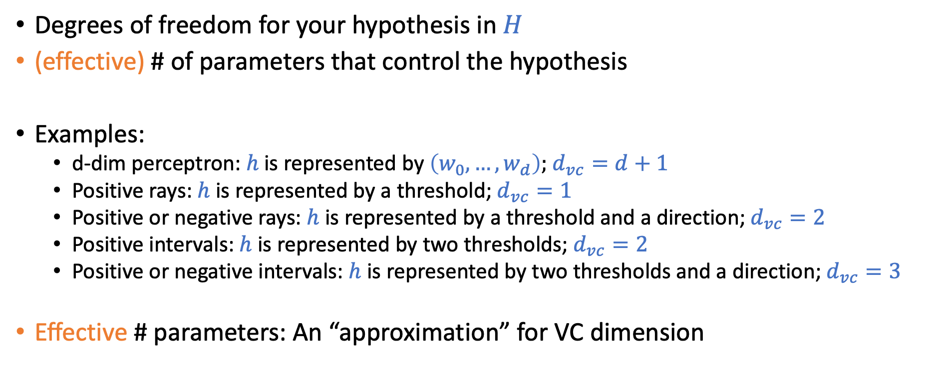
VC “Dimension”
Degrees of freedom for your hypothesis in $H$
(effective) # of parameters that control the hypothesis
Examples:
d-dim perceptron: $h$is represented by $\left(w_{0},…,w_{d}\right);$ $d_{vc}=d+1$
Positive rays: $h$is represented by a threshold; $d_{vc}=1$
Positive or negative rays: $h$ is represented by a threshold and a direction; $d_{vc}=2$
Positive intervals: $h$ is represented by two thresholds; $d_{vc}=2$
Positive or negative intervals: $h$ is represented by two thresholds and a direction; $d_{vc}=3$
Effective # parameters: An “approximation” for VC dimension

Slide 7
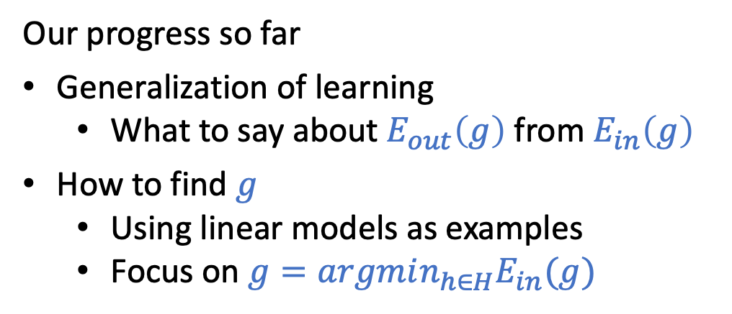
What We Have Taught So Far
The explanation of ”machine learning” from the first lecture
Hypothesis / Model
Our progress so far
Generalization of learning
What to say about $E_{out}\left(g\right)$ from $E_{in}\left(g\right)$
How to find $g$
Using linear models as examples
Focus on $g=argmin_{h∈H}E_{in}(g)$
Data (Historical Customer Data)
Find a hypothesis that “fits” the data (The process requires a lot of computation)
Seems to make sense, but…

Slide 8
Overfitting

Slide 9
Today’s Lecture
The notes are not intended to be comprehensive. They should be accompanied by lectures and/or textbook.
Let me know if you spot errors.

Slide 10
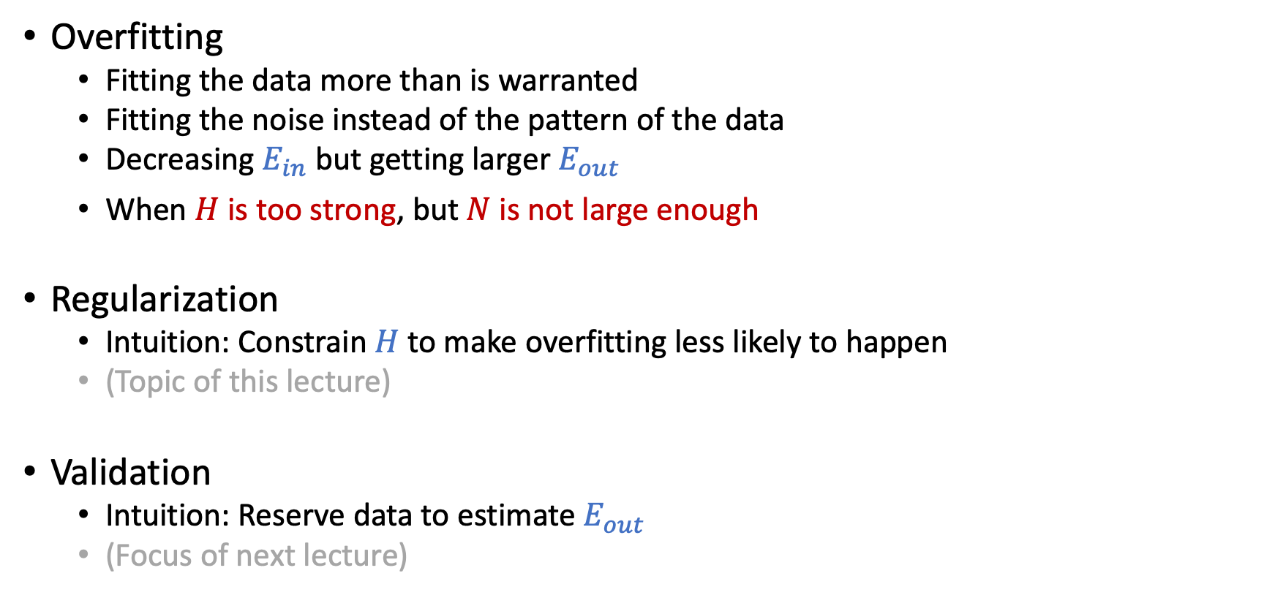
Overfitting and Its Cures
Overfitting
Fitting the data more than is warranted
Fitting the noise instead of the pattern of the data
Decreasing $E_{in}$ but getting larger $E_{out}$
When $H$ is too strong, but $N$ is not large enough
Regularization
Intuition: Constrain $H$to make overfitting less likely to happen
(Topic of this lecture)
Validation
Intuition: Reserve data to estimate $E_{out}$
(Focus of next lecture)

Slide 11
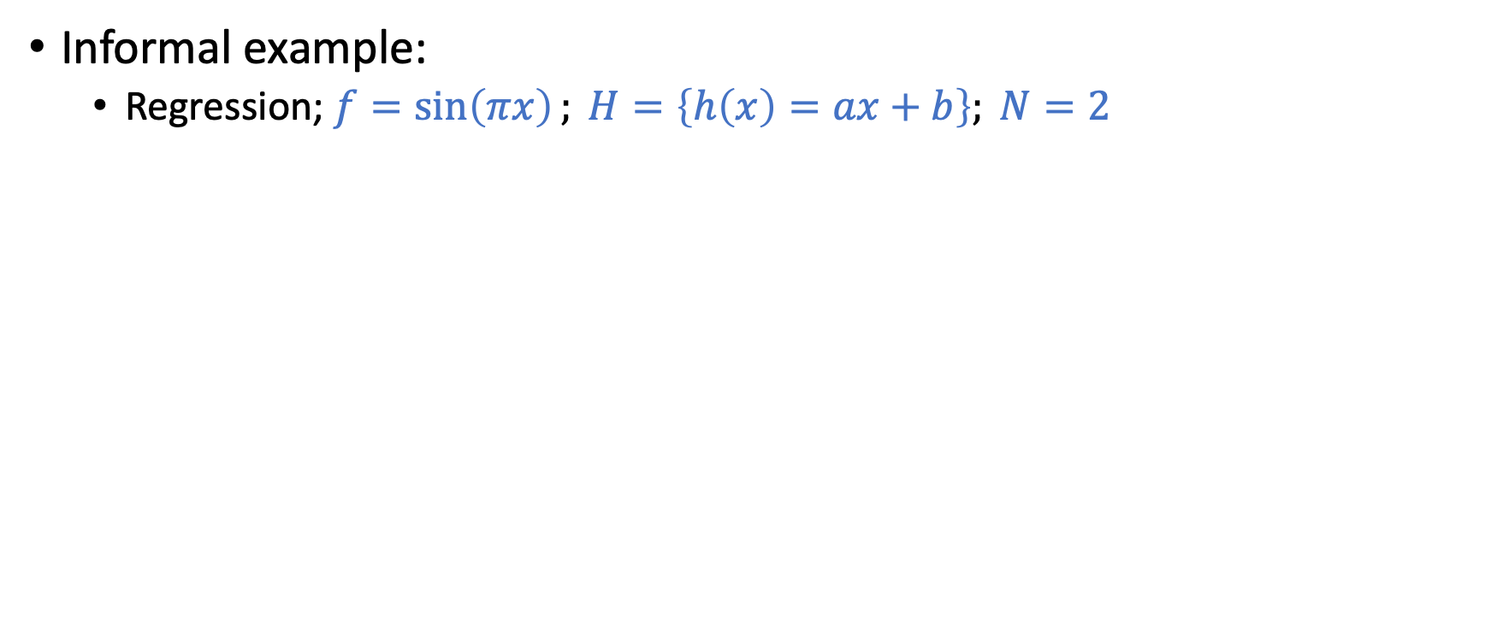

Regularization (Constrain $H$)
Informal example:
Regression; $f=\sin\left(πx\right); H=\left\{h\left(x\right)=ax+b\right\}; N=2$
Regularization:
Constrain the hypothesis set to
avoid large a and b
How to do this in a principled way?

Slide 12
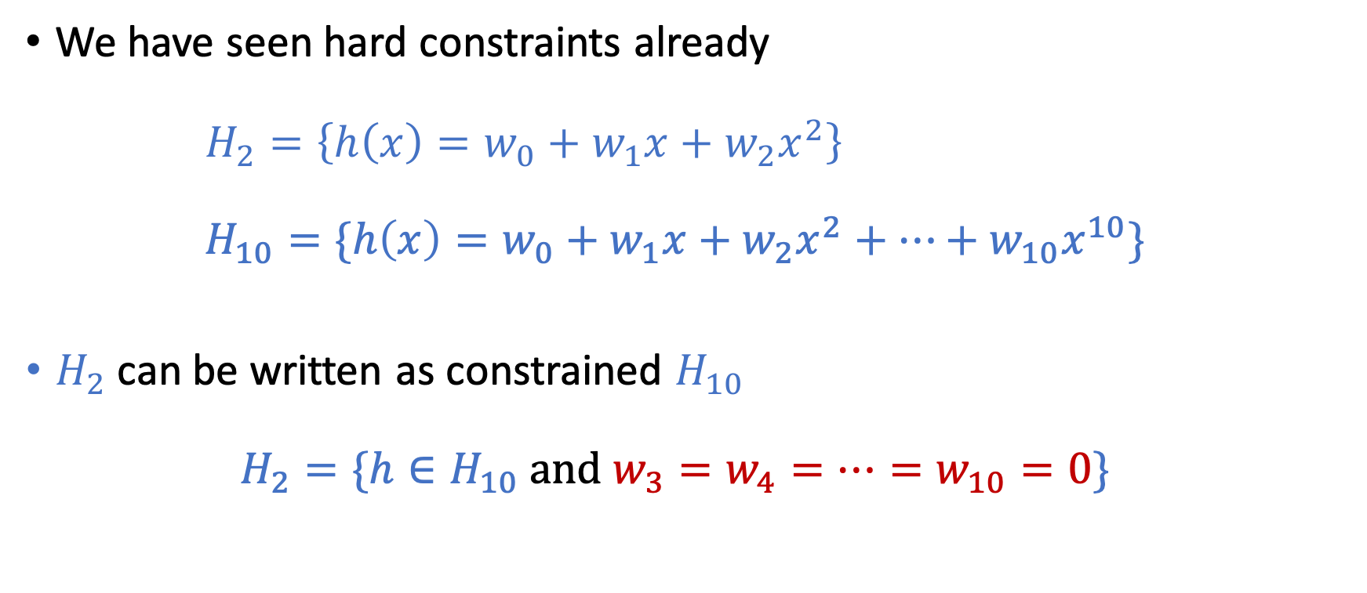
Hard Constraints
We have seen hard constraints already $H_{2}=\left\{h\left(x\right)=w_{0}+w_{1}x+w_{2}x^{2}\right\}$ $H_{10}=\{h\left(x\right)=w_{0}+w_{1}x+w_{2}x^{2}+…+w_{10}x^{10}\}$
$H_{2}$ can be written as constrained $H_{10}$ $H_{2}=\{h∈H_{10} \text{and} w_{3}=w_{4}=…=w_{10}=0\}$
Constraints

Slide 13
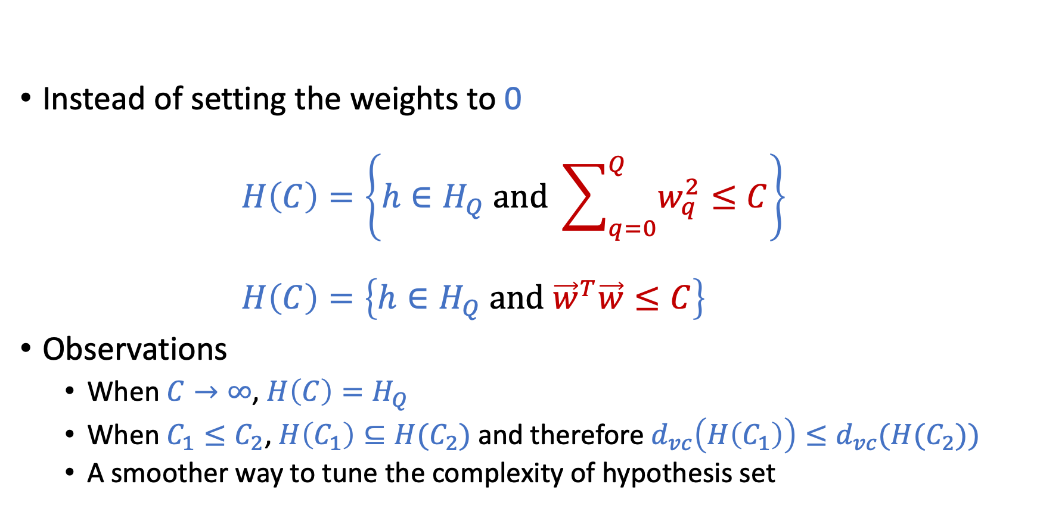
Soft-Order Constraints
Instead of setting the weights to 0 $H\left(C\right)=\left\{h∈H_{Q} \text{and} \sum_{q=0}^{Q}{w_{q}^{2}≤C}\right\}$ $H\left(C\right)=\left\{h∈H_{Q} \text{and} {\vec{w}}^{T}\vec{w}≤C\right\}$
Observations
When $C→∞$, $H\left(C\right)=H_{Q}$
When $C_{1}≤C_{2}$, $H\left(C_{1}\right)⊆H(C_{2})$ and therefore $d_{vc}\left(H\left(C_{1}\right)\right)≤d_{vc}(H(C_{2}))$
A smoother way to tune the complexity of hypothesis set

Slide 14
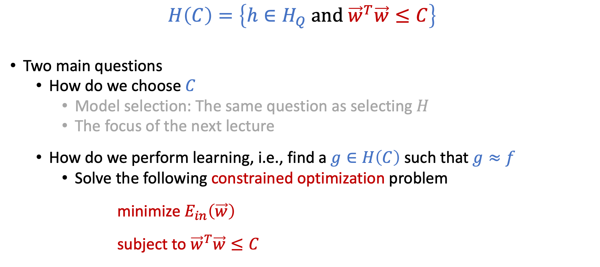
Soft-Order Constraints
$$H\left(C\right)=\left\{h∈H_{Q} \text{and} {\vec{w}}^{T}\vec{w}≤C\right\}$$
Two main questions
How do we choose $C$
Model selection: The same question as selecting $H$
The focus of the next lecture
How do we perform learning, i.e., find a $g∈H\left(C\right)$ such that $g≈f$
Solve the following constrained optimization problem minimize $E_{in}\left(\vec{w}\right)$ subject to ${\vec{w}}^{T}\vec{w}≤C$

Slide 15
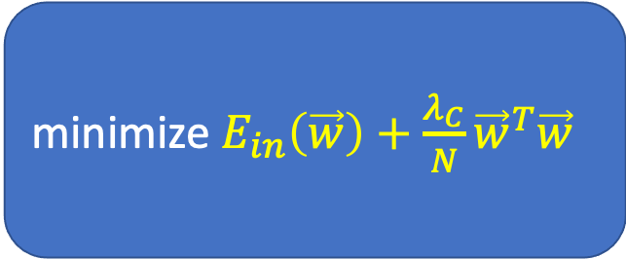
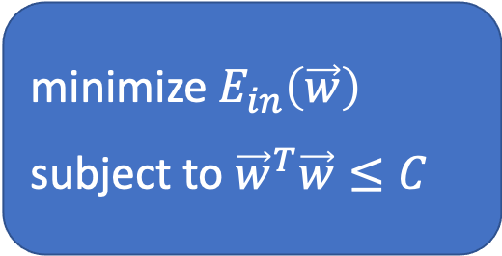
Constrained to Unconstrained Optimization
Constrained optimization ⬄ Unconstrained optimization
Why the above is true?
Will talk about how to utilize Lagrangian relaxation to get this in the 2nd half of the semester
For now, let’s think about it graphically
minimize $E_{in}\left(\vec{w}\right)$
subject to ${\vec{w}}^{T}\vec{w}≤C$
minimize $E_{in}\left(\vec{w}\right)+\frac{λ_{C}}{N}{\vec{w}}^{T}\vec{w}$
equivalent

Slide 16
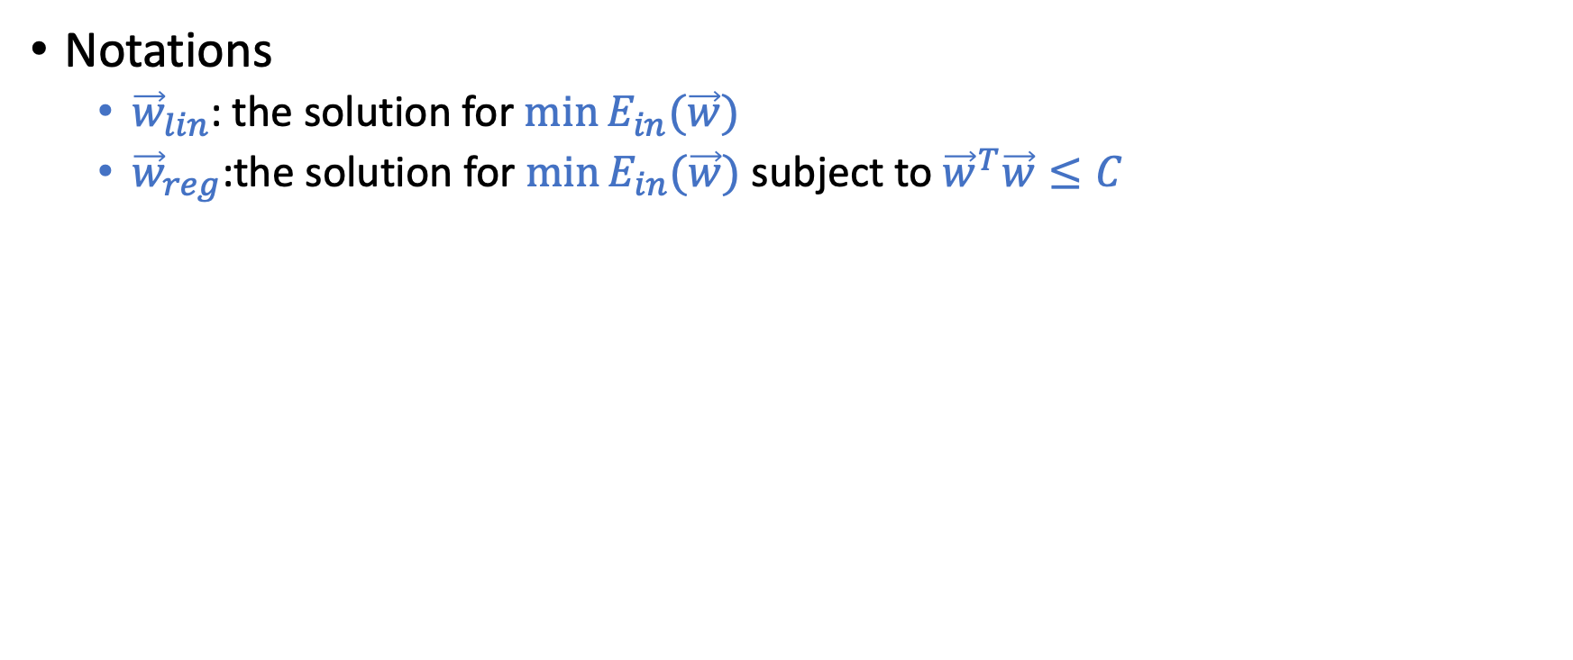

minimize $E_{in}\left(\vec{w}\right)$ subject to ${\vec{w}}^{T}\vec{w}≤C$
Notations
${\vec{w}}_{lin}$: the solution for $\min{E_{in}(\vec{w})}$
${\vec{w}}_{reg}$:the solution for $\min{E_{in}(\vec{w})}$ subject to ${\vec{w}}^{T}\vec{w}≤C$

Slide 17
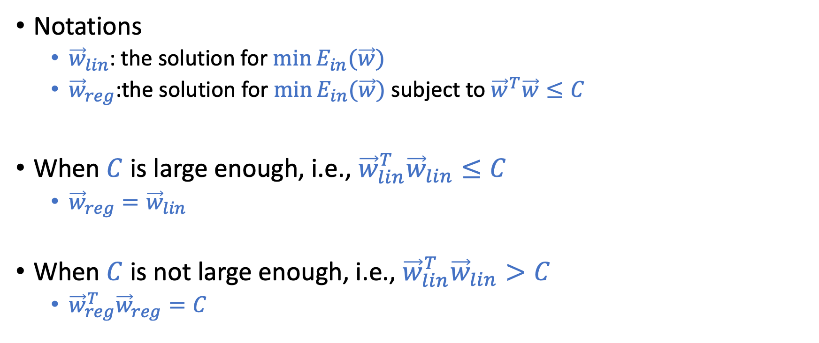
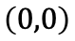

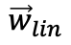
minimize $E_{in}\left(\vec{w}\right)$ subject to ${\vec{w}}^{T}\vec{w}≤C$
Notations
${\vec{w}}_{lin}$: the solution for $\min{E_{in}(\vec{w})}$
${\vec{w}}_{reg}$:the solution for $\min{E_{in}(\vec{w})}$ subject to ${\vec{w}}^{T}\vec{w}≤C$
When $C$ is large enough, i.e., ${\vec{w}}_{lin}^{T}{\vec{w}}_{lin}≤C$
${\vec{w}}_{reg}={\vec{w}}_{lin}$
When $C$ is not large enough, i.e., ${\vec{w}}_{lin}^{T}{\vec{w}}_{lin}>C$
${\vec{w}}_{reg}^{T}{\vec{w}}_{reg}=C$
$${\vec{w}}_{lin}$$
$$\left(0,0\right)$$
$${\vec{w}}^{T}\vec{w}=C$$

Slide 18
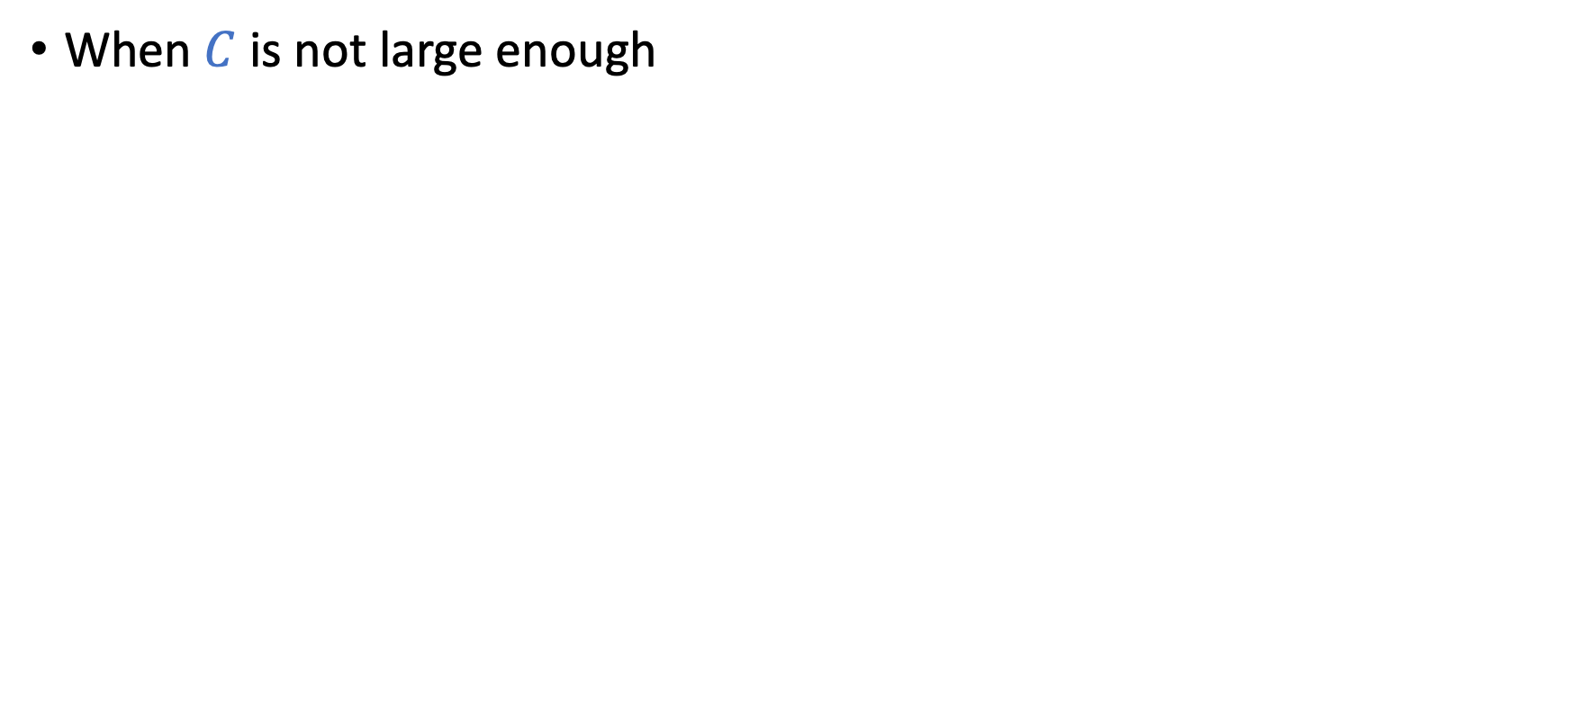
minimize $E_{in}\left(\vec{w}\right)$ subject to ${\vec{w}}^{T}\vec{w}≤C$
When $C$ is not large enough

Slide 19
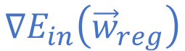
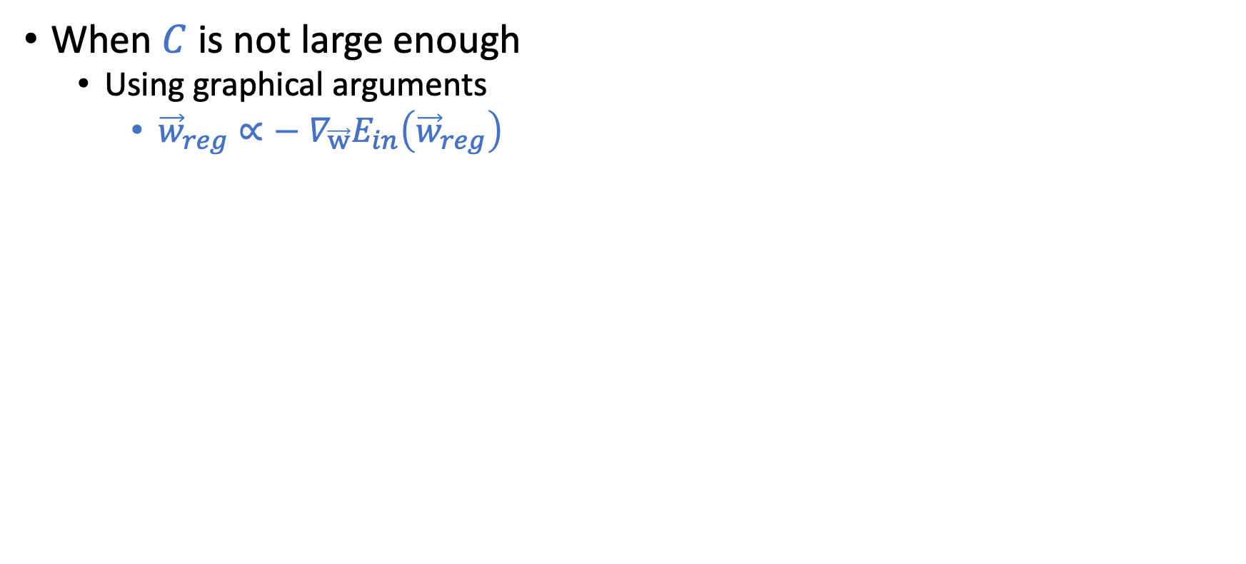
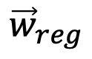
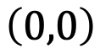

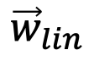
minimize $E_{in}\left(\vec{w}\right)$ subject to ${\vec{w}}^{T}\vec{w}≤C$
When $C$ is not large enough
Using graphical arguments
${\vec{w}}_{reg}∝−$ $∇_{\vec{w}}E_{in}\left({\vec{w}}_{reg}\right)$
That is, we can find some constant $λ_{C}$ such that
$∇_{\vec{w}}E_{in}\left({\vec{w}}_{reg}\right)=−\frac{2λ_{C}}{N}{\vec{w}}_{reg}$
Therefore,
$∇_{\vec{w}}\left(E_{in}\left({\vec{w}}_{reg}\right)+\frac{λ_{C}}{N}{\vec{w}}_{reg}^{T}{\vec{w}}_{reg}\right)=0$
This implies, ${\vec{w}}_{reg}$ is the solution for
minimize $E_{in}\left(\vec{w}\right)+\frac{λ_{C}}{N}{\vec{w}}^{T}\vec{w}$
$${\vec{w}}_{lin}$$
$${\vec{w}}_{reg}$$
$$∇E_{in}\left({\vec{w}}_{reg}\right)$$
$$\left(0,0\right)$$
$${\vec{w}}^{T}\vec{w}=C$$

Slide 20
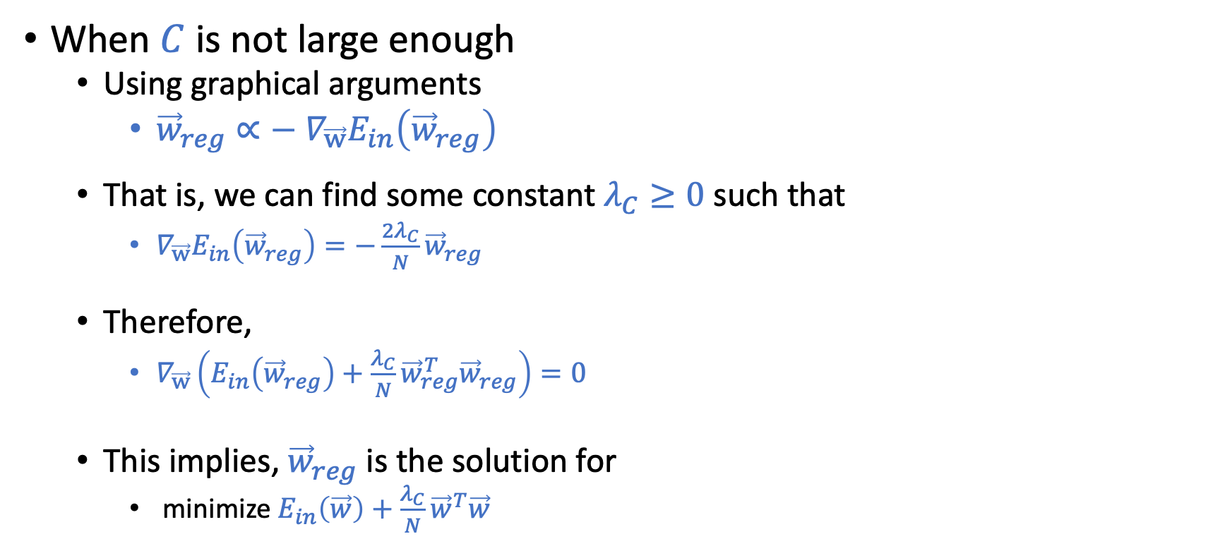
minimize $E_{in}\left(\vec{w}\right)$ subject to ${\vec{w}}^{T}\vec{w}≤C$
When $C$ is not large enough
Using graphical arguments
${\vec{w}}_{reg}∝−$ $∇_{\vec{w}}E_{in}\left({\vec{w}}_{reg}\right)$
That is, we can find some constant $λ_{C}≥0$ such that
$∇_{\vec{w}}E_{in}\left({\vec{w}}_{reg}\right)=−\frac{2λ_{C}}{N}{\vec{w}}_{reg}$
Therefore,
$∇_{\vec{w}}\left(E_{in}\left({\vec{w}}_{reg}\right)+\frac{λ_{C}}{N}{\vec{w}}_{reg}^{T}{\vec{w}}_{reg}\right)=0$
This implies, ${\vec{w}}_{reg}$ is the solution for
minimize $E_{in}\left(\vec{w}\right)+\frac{λ_{C}}{N}{\vec{w}}^{T}\vec{w}$
$${\vec{w}}_{lin}$$
$${\vec{w}}_{reg}$$
$$∇E_{in}\left({\vec{w}}_{reg}\right)$$
$$\left(0,0\right)$$
$${\vec{w}}^{T}\vec{w}=C$$

Slide 21
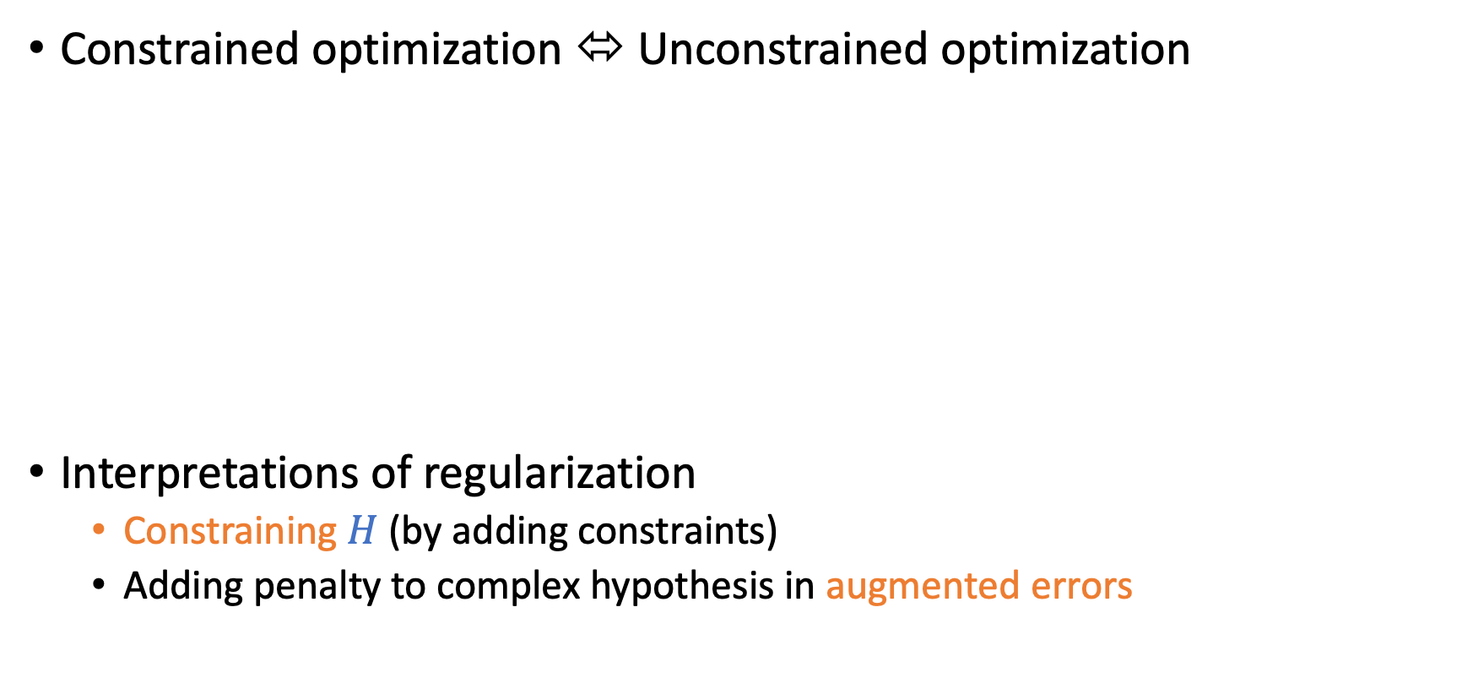

Constrained to Unconstrained Optimization
Constrained optimization ⬄ Unconstrained optimization
Interpretations of regularization
Constraining $H$ (by adding constraints)
Adding penalty to complex hypothesis in augmented errors
minimize $E_{in}\left(\vec{w}\right)$
subject to ${\vec{w}}^{T}\vec{w}≤C$
minimize $E_{in}\left(\vec{w}\right)+\frac{λ_{C}}{N}{\vec{w}}^{T}\vec{w}$
equivalent
augmented error

Slide 22
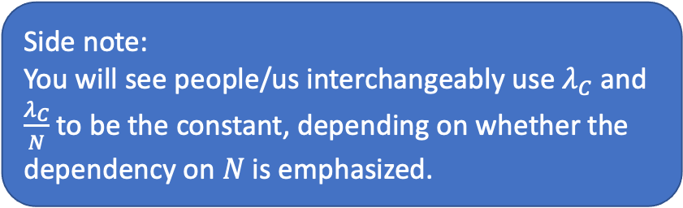
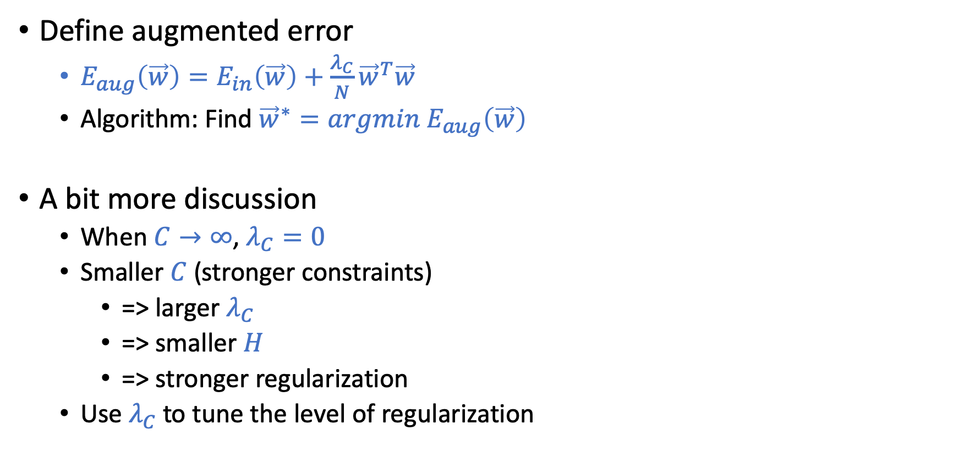
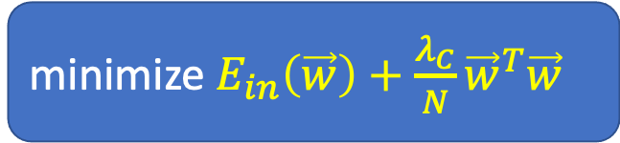
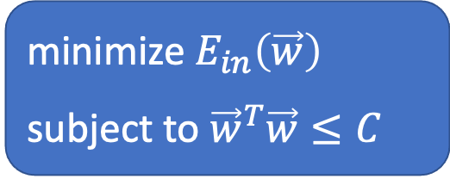

Augmented Error
${\vec{w}}^{T}\vec{w}:$ weight decay
minimize $E_{in}\left(\vec{w}\right)$
subject to ${\vec{w}}^{T}\vec{w}≤C$
Define augmented error
$E_{aug}\left(\vec{w}\right)=E_{in}\left(\vec{w}\right)+\frac{λ_{C}}{N}{\vec{w}}^{T}\vec{w}$
Algorithm: Find ${\vec{w}}^{∗}=argmin{ E}_{aug}\left(\vec{w}\right)$
A bit more discussion
When $C→∞$, $λ_{C}=0$
Smaller $C$ (stronger constraints)
=> larger $λ_{C}$
=> smaller $H$
=> stronger regularization
Use $λ_{C}$ to tune the level of regularization
minimize $E_{in}\left(\vec{w}\right)+\frac{λ_{C}}{N}{\vec{w}}^{T}\vec{w}$
Side note:
You will see people/us interchangeably use $λ_{C}$ and $\frac{λ_{C}}{N}$ to be the constant, depending on whether the dependency on $N$ is emphasized.

Slide 23
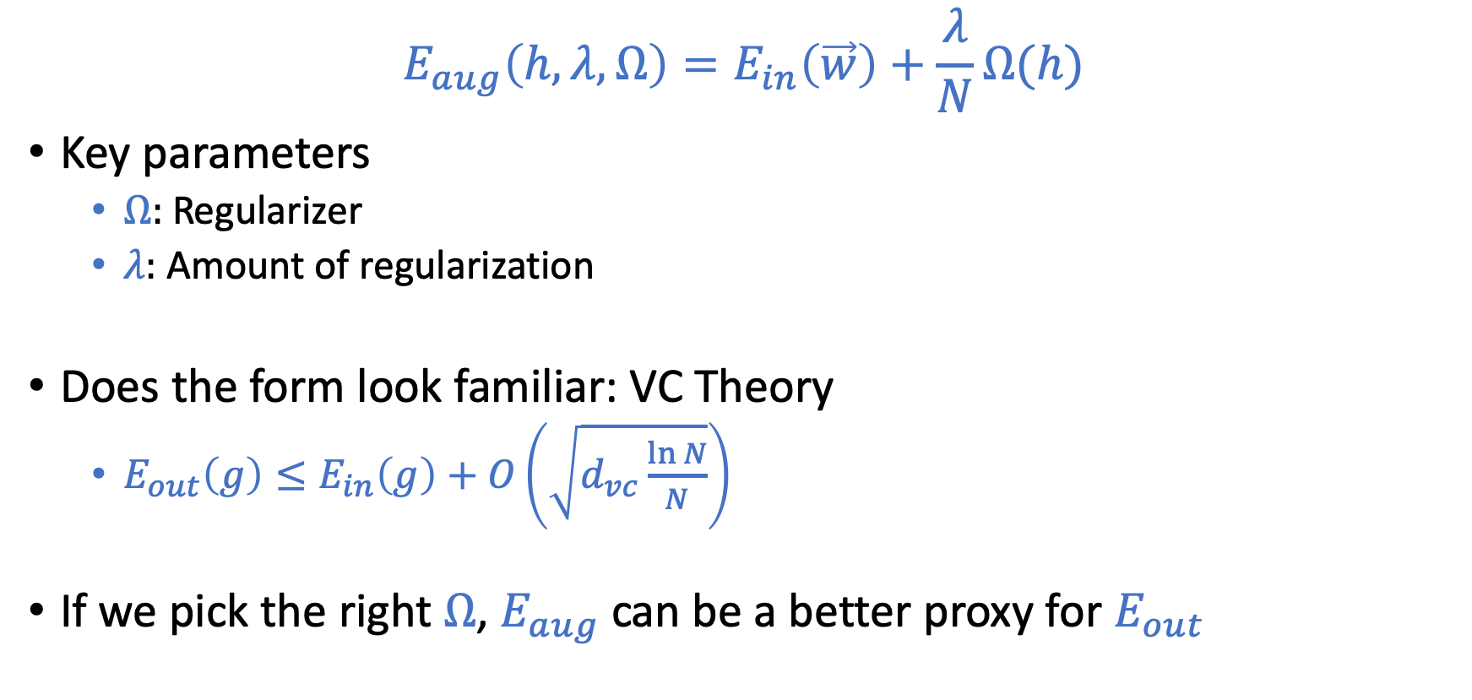
General Form of Regularization
$$E_{aug}\left(h,λ,Ω\right)=E_{in}\left(\vec{w}\right)+\frac{λ}{N}Ω(h)$$
Key parameters
$Ω:$ Regularizer
$λ:$ Amount of regularization
Does the form look familiar: VC Theory
$E_{out}\left(g\right)≤E_{in}\left(g\right)+O\left(\sqrt{d_{vc}\frac{\ln{N}}{N}}\right)$
If we pick the right $Ω$, $E_{aug}$ can be a better proxy for $E_{out}$

Slide 24
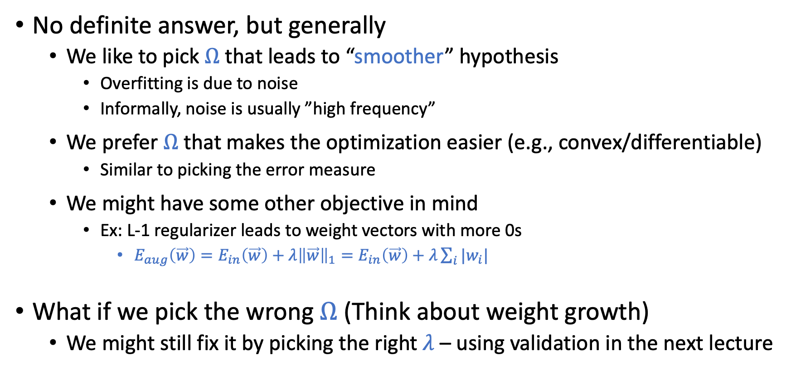
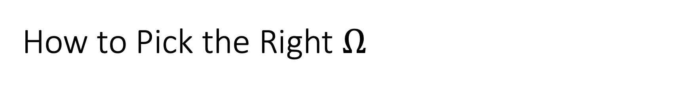
How to Pick the Right $Ω$
No definite answer, but generally
We like to pick $Ω$ that leads to “smoother” hypothesis
Overfitting is due to noise
Informally, noise is usually ”high frequency”
We prefer $Ω$ that makes the optimization easier (e.g., convex/differentiable)
Similar to picking the error measure
We might have some other objective in mind
Ex: L-1 regularizer leads to weight vectors with more 0s
$E_{aug}\left(\vec{w}\right)=E_{in}\left(\vec{w}\right)+λ{\left\|\vec{w}\right\|}_{1}=E_{in}\left(\vec{w}\right)+λ\sum_{i}{|w_{i}|}$
What if we pick the wrong $Ω$ (Think about weight growth)
We might still fix it by picking the right $λ$ – using validation in the next lecture

Slide 25
More Discussion on Regularization

Slide 26
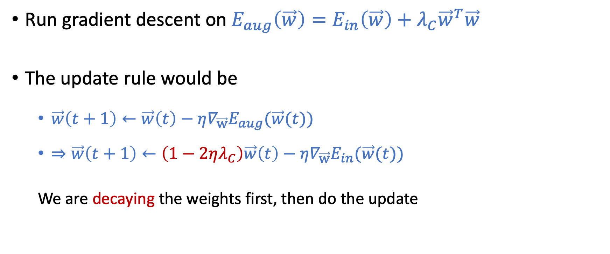

Why ${\vec{w}}^{T}\vec{w}$ is Called Weight Decay
Run gradient descent on $E_{aug}\left(\vec{w}\right)=E_{in}\left(\vec{w}\right)+λ_{C}{\vec{w}}^{T}\vec{w}$
The update rule would be
$\vec{w}\left(t+1\right)←\vec{w}\left(t\right)−η∇_{\vec{w}}E_{aug}(\vec{w}(t))$
$⇒\vec{w}\left(t+1\right)←\left(1−2ηλ_{C}\right)\vec{w}\left(t\right)−η∇_{\vec{w}}E_{in}(\vec{w}(t))$
We are decaying the weights first, then do the update
Proving this is in your HW3.

Slide 27
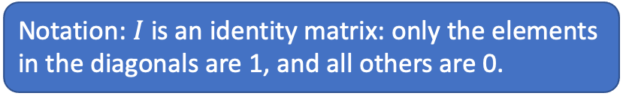
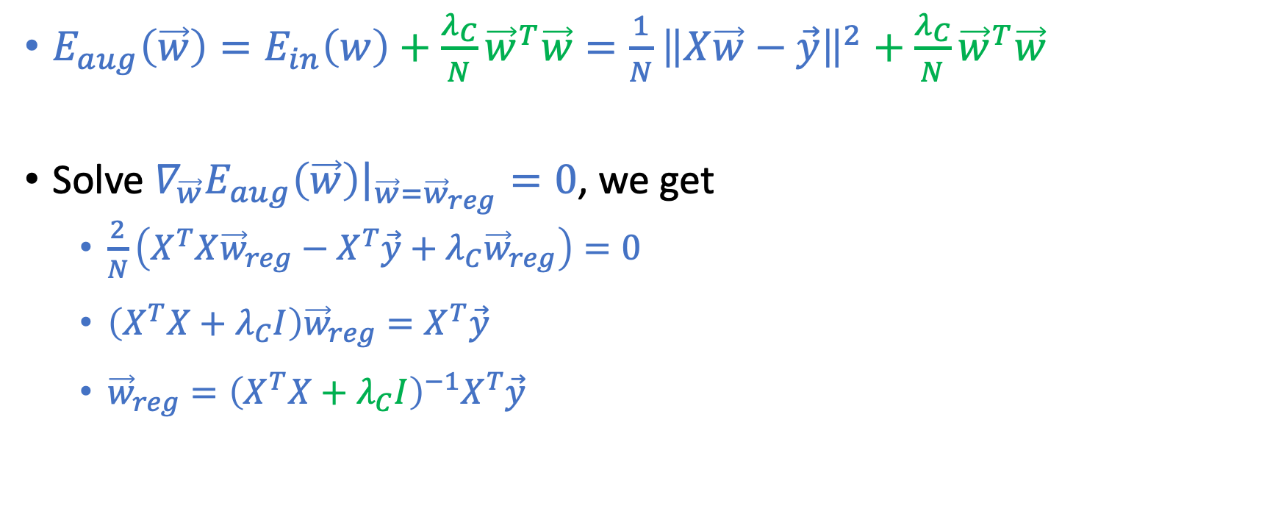
Linear Regression with Weight Decay
$E_{aug}\left(\vec{w}\right)=E_{in}\left(w\right)+\frac{λ_{C}}{N}{\vec{w}}^{T}\vec{w}=\frac{1}{N}{\left\|X\vec{w}−\vec{y}\right\|}^{2}+\frac{λ_{C}}{N}{\vec{w}}^{T}\vec{w}$
Solve $∇_{\vec{w}}E_{aug}\left(\vec{w}\right){\left.​\right|}_{\vec{w}={\vec{w}}_{reg}}=0$, we get
$\frac{2}{N}\left(X^{T}X{\vec{w}}_{reg}−X^{T}\vec{y}+λ_{C}{\vec{w}}_{reg}\right)=0$
$\left(X^{T}X+λ_{C}I\right){\vec{w}}_{reg}=X^{T}\vec{y}$
${\vec{w}}_{reg}={\left(X^{T}X+λ_{C}I\right)}^{−1}X^{T}\vec{y}$
Notation: $I$ is an identity matrix: only the elements in the diagonals are 1, and all others are 0.
This is called “Ridge Regression” in statistics.

Slide 28
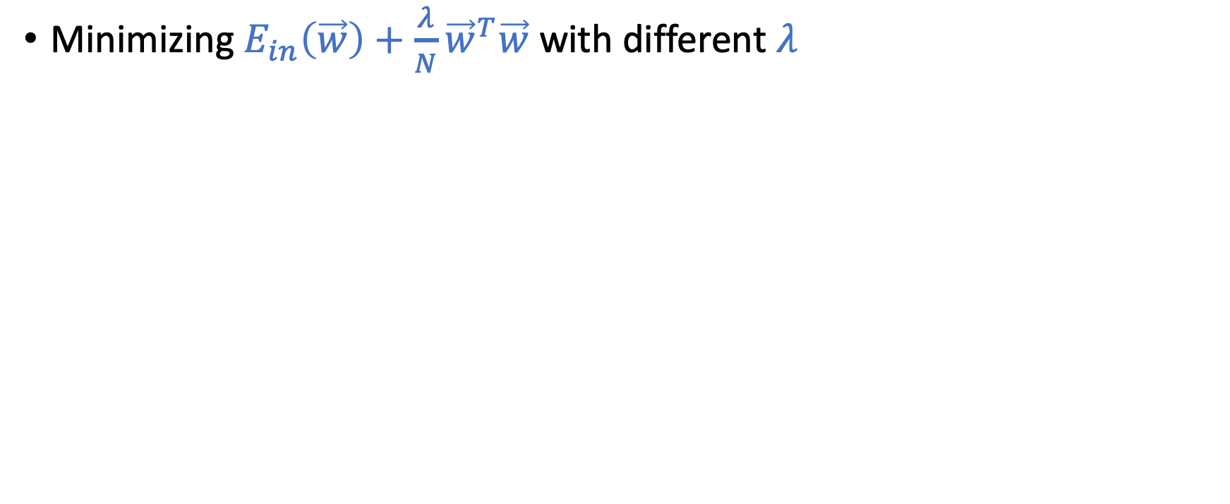
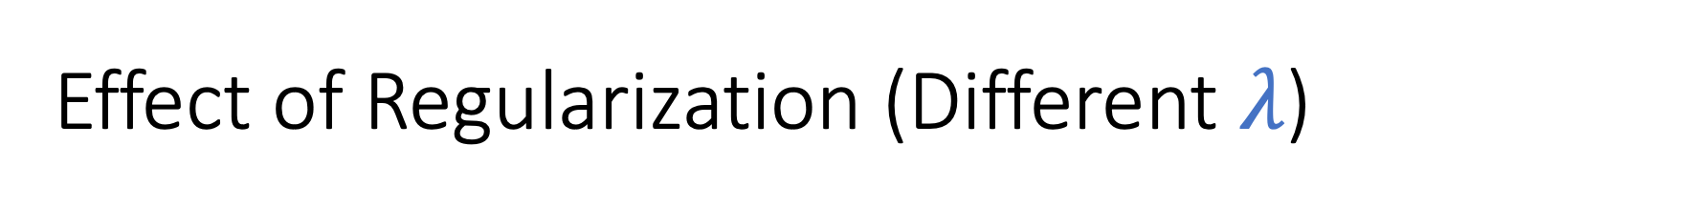
Effect of Regularization (Different $λ$)
Minimizing $E_{in}\left(\vec{w}\right)+\frac{λ}{N}{\vec{w}}^{T}\vec{w}$ with different $λ$

Slide 29

Overfitting and Underfitting
Need to pick the right $λ$:
Using validation: Focus of next lecture

Slide 30

Variations on Weight Decay (Different $Ω$)

Slide 31
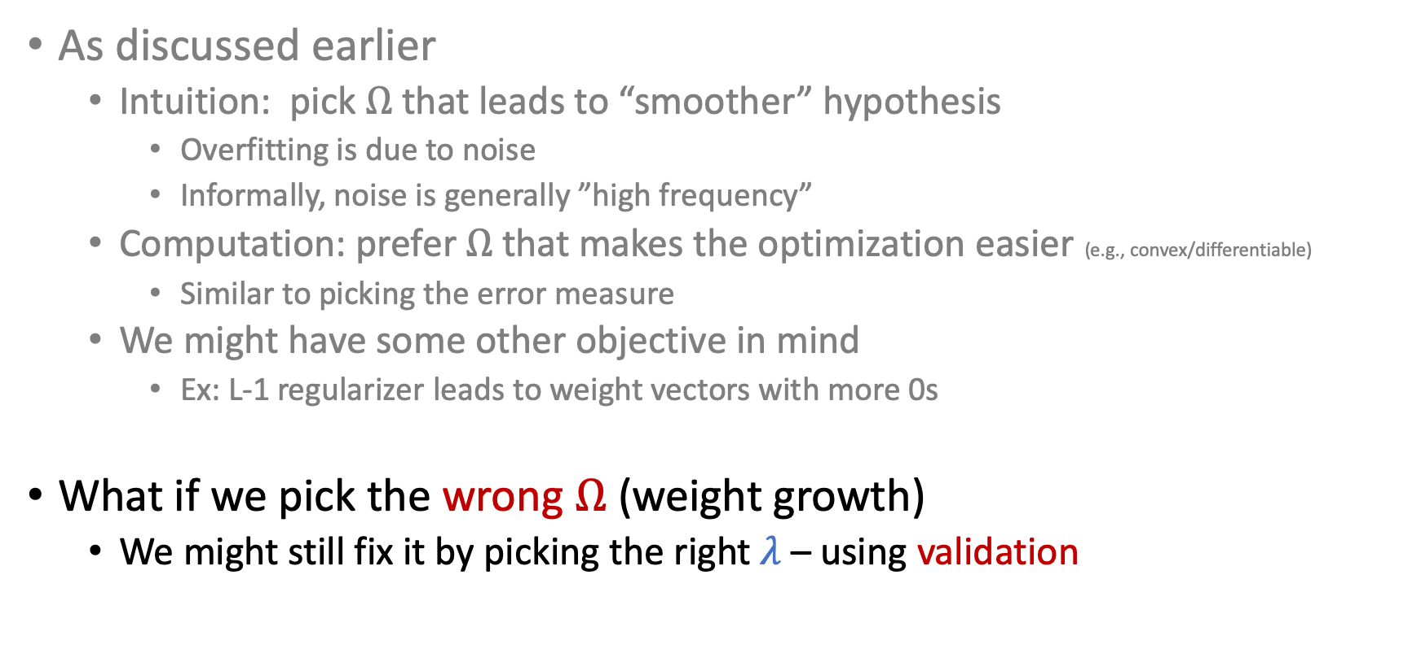
How to Pick the Right $Ω$
As discussed earlier
Intuition: pick $Ω$ that leads to “smoother” hypothesis
Overfitting is due to noise
Informally, noise is generally ”high frequency”
Computation: prefer $Ω$ that makes the optimization easier (e.g., convex/differentiable)
Similar to picking the error measure
We might have some other objective in mind
Ex: L-1 regularizer leads to weight vectors with more 0s
What if we pick the wrong $Ω$ (weight growth)
We might still fix it by picking the right $λ$ – using validation

Slide 32
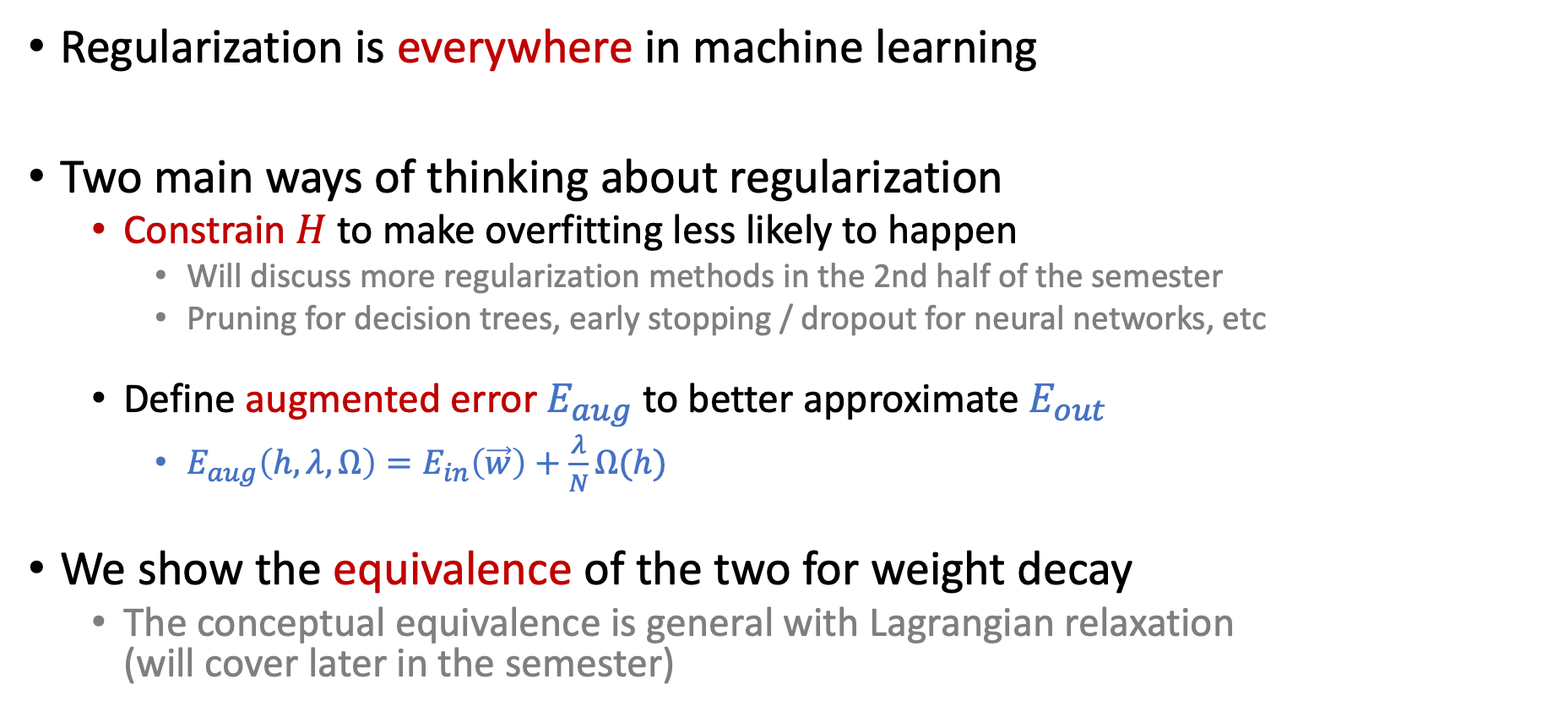
Summarizing Regularization
Regularization is everywhere in machine learning
Two main ways of thinking about regularization
Constrain $H$ to make overfitting less likely to happen
Will discuss more regularization methods in the 2nd half of the semester
Pruning for decision trees, early stopping / dropout for neural networks, etc
Define augmented error $E_{aug}$ to better approximate $E_{out}$
$E_{aug}\left(h,λ,Ω\right)=E_{in}\left(\vec{w}\right)+\frac{λ}{N}Ω(h)$
We show the equivalence of the two for weight decay
The conceptual equivalence is general with Lagrangian relaxation (will cover later in the semester)

Slide 33
Validation

Slide 34
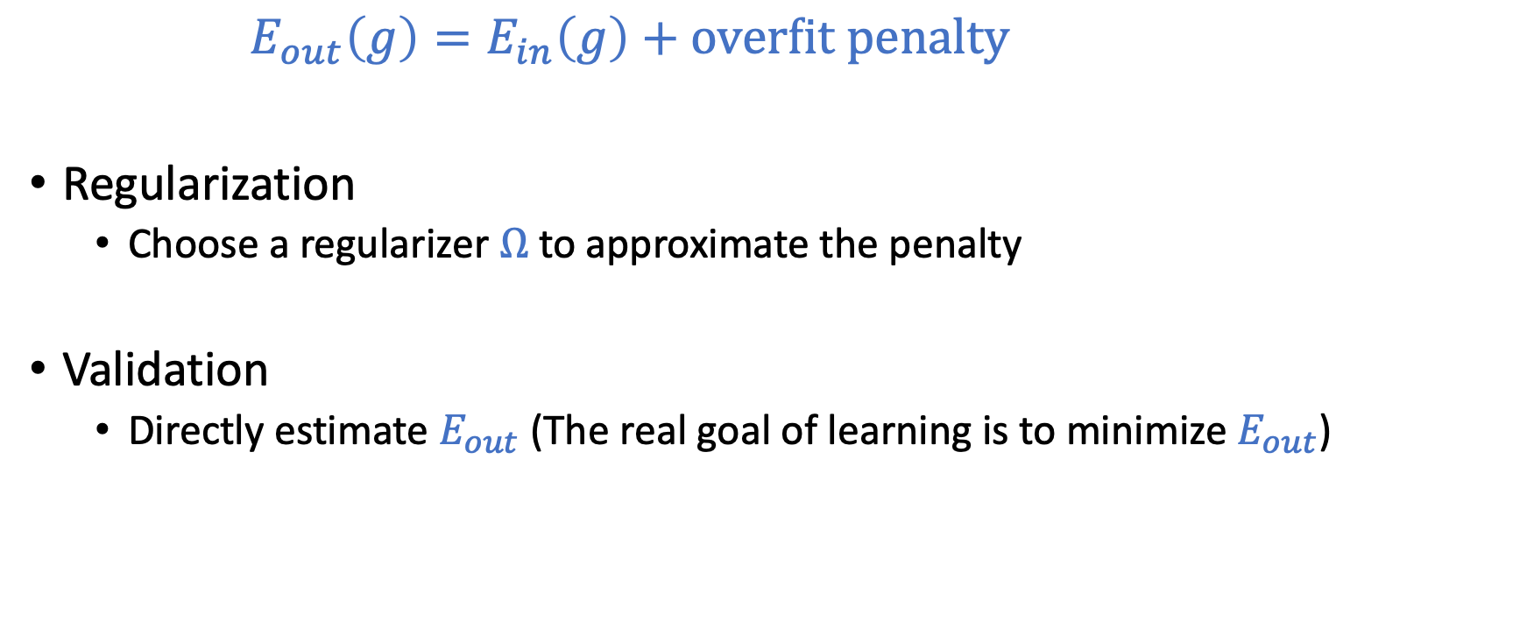
Prevent Overfitting
$E_{out}\left(g\right)=E_{in}\left(g\right)+\text{overfit} \text{penalty}$
Regularization
Choose a regularizer $Ω$ to approximate the penalty
Validation
Directly estimate $E_{out}$ (The real goal of learning is to minimize $E_{out}$)

Slide 35
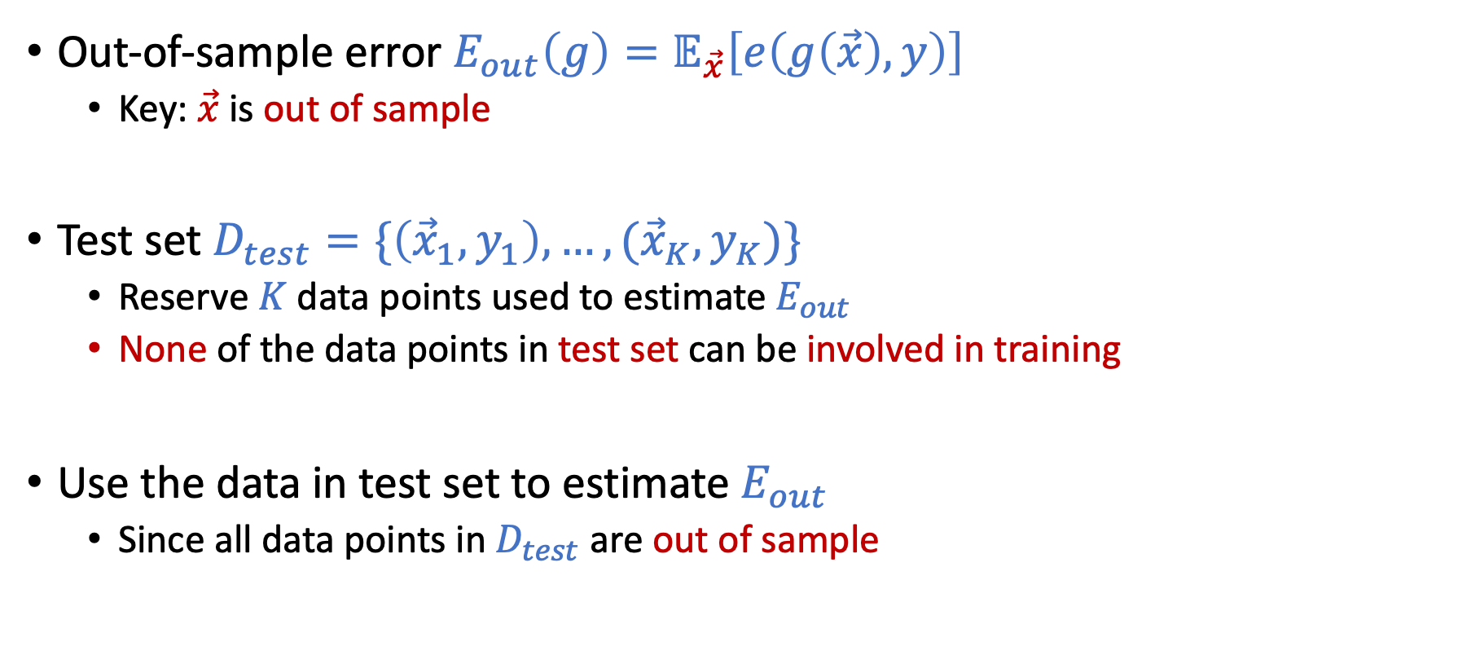
Review: Test Set
Out-of-sample error $E_{out}\left(g\right)=𝔼_{\vec{x}}\left[e\left(g\left(\vec{x}\right),y\right)\right]$
Key: $\vec{x}$ is out of sample
Test set $D_{test}=\{\left({\vec{x}}_{1},y_{1}\right),…,({\vec{x}}_{K},y_{K})\}$
Reserve $K$ data points used to estimate $E_{out}$
None of the data points in test set can be involved in training
Use the data in test set to estimate $E_{out}$
Since all data points in $D_{test}$ are out of sample

Slide 36
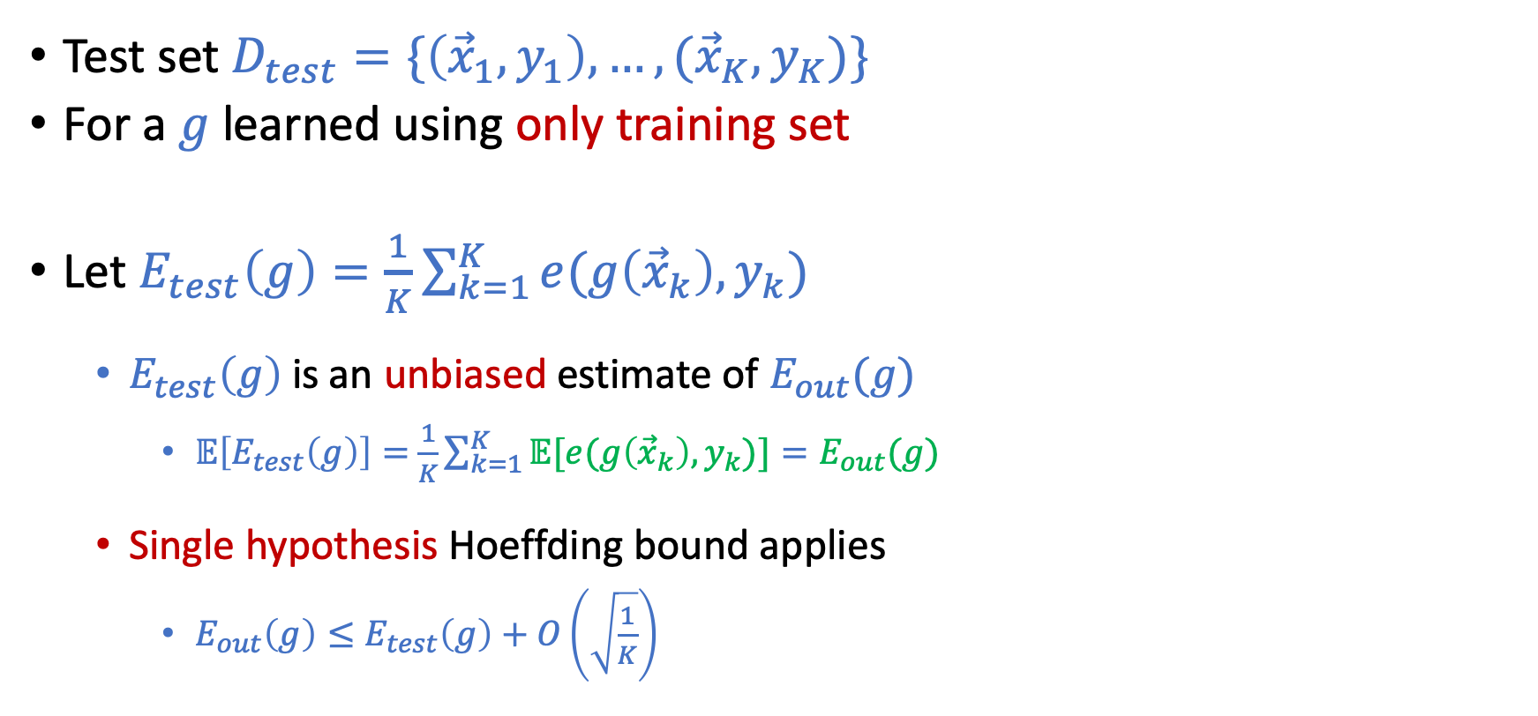
Test Set
Test set $D_{test}=\{\left({\vec{x}}_{1},y_{1}\right),…,({\vec{x}}_{K},y_{K})\}$
For a $g$ learned using only training set
Let $E_{test}\left(g\right)=\frac{1}{K}\sum_{k=1}^{K}{e(g\left({\vec{x}}_{k}\right),y_{k})}$
$E_{test}\left(g\right)$ is an unbiased estimate of $E_{out}(g)$
$𝔼\left[E_{test}\left(g\right)\right]=$ $\frac{1}{K}\sum_{k=1}^{K}{𝔼[e(g\left({\vec{x}}_{k}\right),y_{k})}]=E_{out}(g)$
Single hypothesis Hoeffding bound applies
$E_{out}\left(g\right)≤E_{test}\left(g\right)+O\left(\sqrt{\frac{1}{K}}\right)$

Slide 37
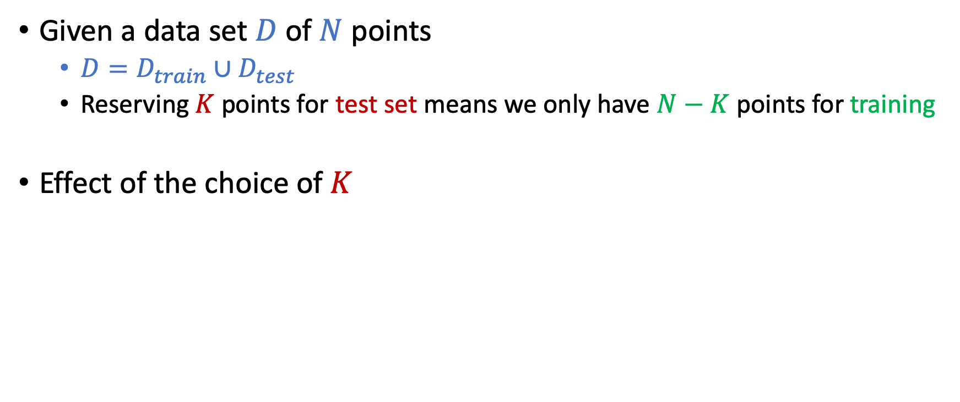
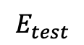
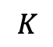
Where are Test Set From?
Given a data set $D$of $N$ points
$D=D_{train}∪D_{test}$
Reserving $K$ points for test set means we only have $N−K$ points for training
Effect of the choice of $K$
$$E_{test}$$
$$K$$

Slide 38
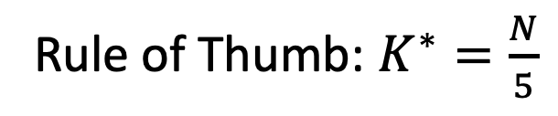
Where are Test Set From?
Given a data set $D$of $N$ points
$D=D_{train}∪D_{test}$
Reserving $K$ points for test set means we only have $N−K$ points for training
Effect of the choice of $K$
Rule of Thumb: $K^{∗}=\frac{N}{5}$
$$E_{test}$$
$$K$$

Slide 39
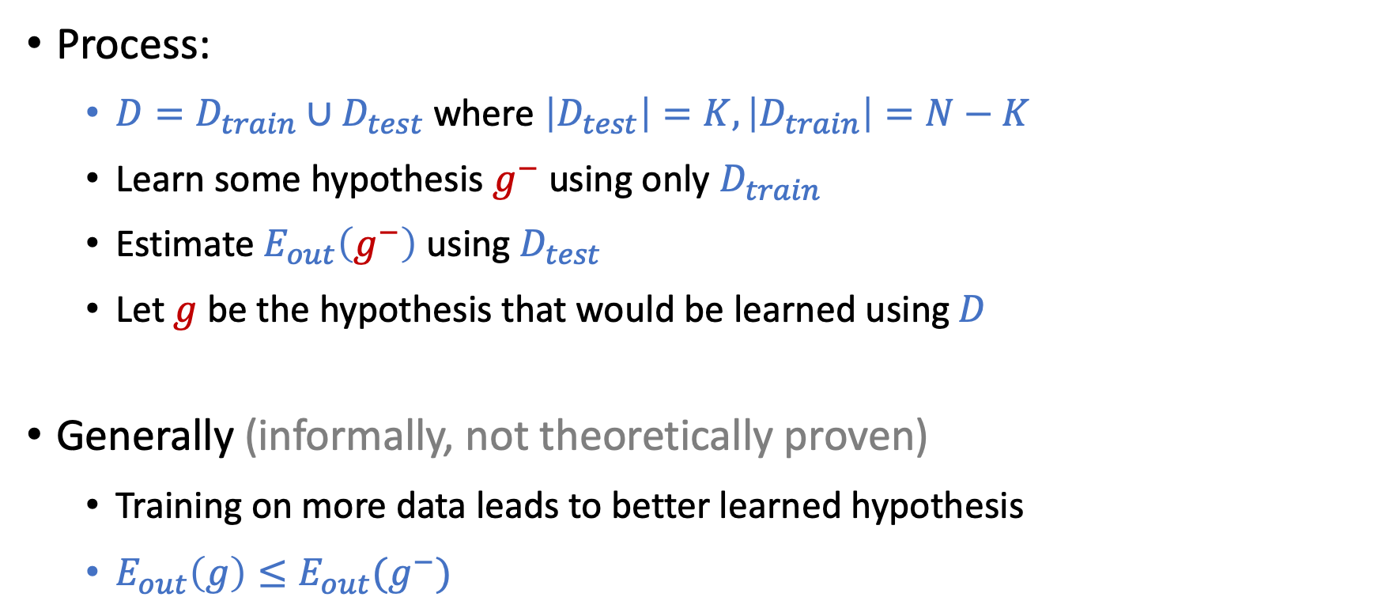

Utilizing the Whole $D$
Process:
$D=D_{train}∪D_{test}$ where $\left|D_{test}\right|=K, \left|D_{train}\right|=N−K$
Learn some hypothesis $g^{−}$ using only $D_{train}$
Estimate $E_{out}\left(g^{−}\right)$ using $D_{test}$
Let $g$ be the hypothesis that would be learned using $D$
Generally (informally, not theoretically proven)
Training on more data leads to better learned hypothesis
$E_{out}\left(g\right)≤E_{out}(g^{−})$

Slide 40
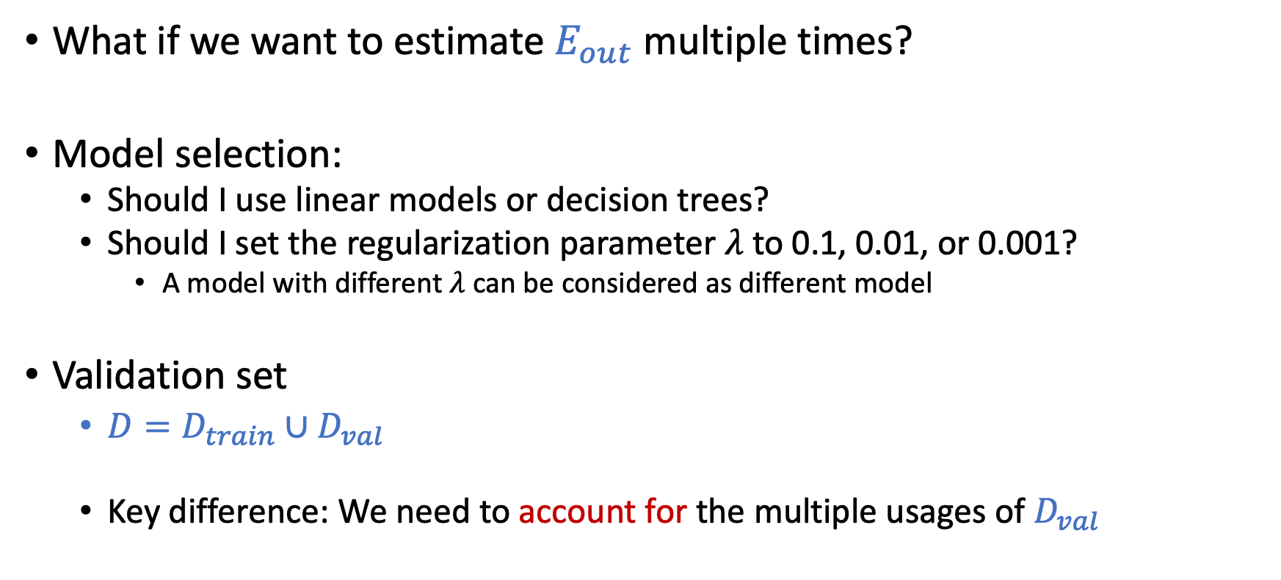
Validation: Beyond Test Set
What if we want to estimate $E_{out}$ multiple times?
Model selection:
Should I use linear models or decision trees?
Should I set the regularization parameter $λ$ to 0.1, 0.01, or 0.001?
A model with different $λ$ can be considered as different model
Validation set
$D=D_{train}∪D_{val}$
Key difference: We need to account for the multiple usages of $D_{val}$

Slide 41
VC Dimension of d-dim Perceptron

Slide 42
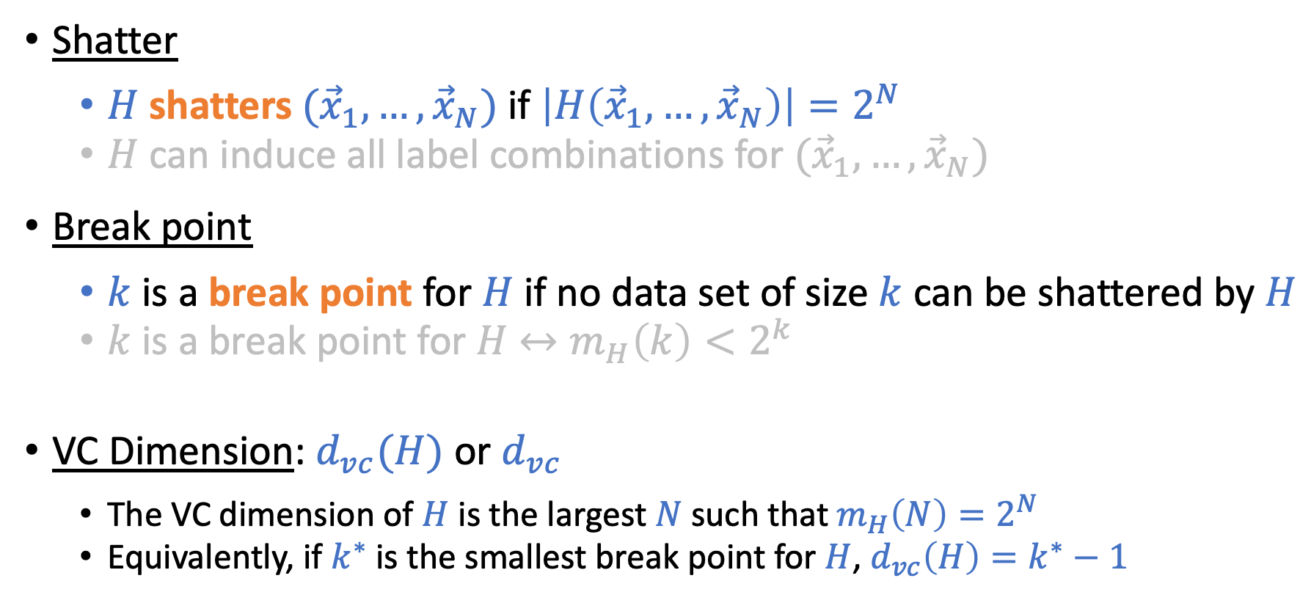
Recall the Definitions
Shatter
$H$ shatters $({\vec{x}}_{1},…,{\vec{x}}_{N})$ if $\left|H\left({\vec{x}}_{1},…,{\vec{x}}_{N}\right)\right|=2^{N}$
$H$ can induce all label combinations for $({\vec{x}}_{1},…,{\vec{x}}_{N})$
Break point
$k$ is a break point for $H$ if no data set of size $k$ can be shattered by $H$
$k$ is a break point for $H$ $↔m_{H}\left(k\right)<2^{k}$
VC Dimension: $d_{vc}(H)$ or $d_{vc}$
The VC dimension of $H$ is the largest $N$ such that $m_{H}\left(N\right)=2^{N}$
Equivalently, if $k^{∗}$ is the smallest break point for $H$, $d_{vc}\left(H\right)=k^{∗}−1$

Slide 43
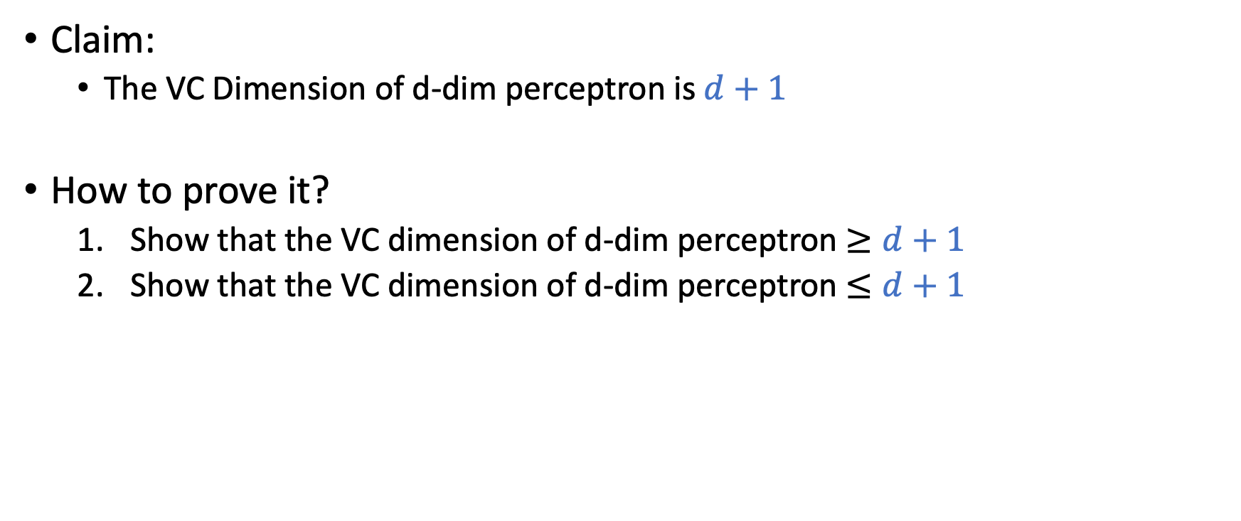
VC Dimension of d-dimension Perceptron
Claim:
The VC Dimension of d-dim perceptron is $d+1$
How to prove it?
Show that the VC dimension of d-dim perceptron $≥d+1$
Show that the VC dimension of d-dim perceptron $≤d+1$

Slide 44

To prove $d_{vc}\left(H\right)≥d+1,$ what do we need to prove?
There is a set of $d+1$points that can be shattered by $H$
There is a set of $d+1$points that cannot be shattered by $H$
Every set of $d+1$ points can be shattered by $H$
Every set of $d+1$ points cannot be shattered by $H$

Slide 45

To prove $d_{vc}\left(H\right)≥d+1,$ what do we need to prove?
There is a set of $d+1$points that can be shattered by $H$
There is a set of $d+1$points that cannot be shattered by $H$
Every set of $d+1$ points can be shattered by $H$
Every set of $d+1$ points cannot be shattered by $H$

Slide 46

To prove $d_{vc}\left(H\right)≥d+1,$ what do we need to prove?
There is a set of $d+1$points that can be shattered by $H$
There is a set of $d+1$points that cannot be shattered by $H$
Every set of $d+1$ points can be shattered by $H$
Every set of $d+1$ points cannot be shattered by $H$
To prove $d_{vc}\left(H\right)≤d+1,$ what do we need to prove?
There is a set of $d+1$points that can be shattered by $H$
There is a set of $d+2$points that cannot be shattered by $H$
Every set of $d+2$ points can be shattered by $H$
Every set of $d+1$ points cannot be shattered by $H$
Every set of $d+2$ points cannot be shattered by $H$

Slide 47

To prove $d_{vc}\left(H\right)≥d+1,$ what do we need to prove?
There is a set of $d+1$points that can be shattered by $H$
There is a set of $d+1$points that cannot be shattered by $H$
Every set of $d+1$ points can be shattered by $H$
Every set of $d+1$ points cannot be shattered by $H$
To prove $d_{vc}\left(H\right)≤d+1,$ what do we need to prove?
There is a set of $d+1$points that can be shattered by $H$
There is a set of $d+2$points that cannot be shattered by $H$
Every set of $d+2$ points can be shattered by $H$
Every set of $d+1$ points cannot be shattered by $H$
Every set of $d+2$ points cannot be shattered by $H$

Slide 48
To prove $d_{vc}\left(H\right)≥d+1,$ what do we need to prove? There is a set of $d+1$points that can be shattered by $H$
To prove $d_{vc}\left(H\right)≤d+1,$ what do we need to prove? Every set of $d+2$ points cannot be shattered by $H$

Slide 49


To prove $d_{vc}\left(H\right)≥d+1,$ what do we need to prove? There is a set of $d+1$points that can be shattered by $H$
To prove $d_{vc}\left(H\right)≤d+1,$ what do we need to prove? Every set of $d+2$ points cannot be shattered by $H$
Proof Sketch:
1. Let’s construct a dataset of $d+1$ points: $X=\left[\begin{matrix}{\vec{x}}_{1}^{T} \\ ⋮ \\ {\vec{x}}_{d+1}^{T}\end{matrix}\right]=\left[\begin{matrix}\begin{matrix}1 & 0 & 0 \\ 1 & 0 & 0\end{matrix} & \begin{matrix}… & 0 & 0 \\ … & 0 & 1\end{matrix} \\ \begin{matrix} 1 & 0 & 0 \\ … & … & … \\ 1 & 1 & 0\end{matrix} & \begin{matrix}… & 1 & 0 \\ … & … & … \\ … & 0 & 0\end{matrix}\end{matrix}\right]$; It’s easy to check that $X^{−1}$ exist
2. For any possible dichotomy $\vec{y},$ there exists a $\vec{w}$ such that $X\vec{w}=\vec{y},$ i.e., $\vec{w}=X^{−1}\vec{y}$
3. Therefore, d-dim perceptron can shatter $X$
Proof Sketch:
For every set of $d+2$ points (in d+1 dimensions), there exists a point that can be written as linear combinations of the others.
Denote the point ${\vec{x}}_{d+2}$, we have ${\vec{x}}_{d+2}=\sum_{i=1}^{d+1}{a_{i}}{\vec{x}}_{i}$
Consider the dichotomy ($y_{1},…,y_{d+2})=(sign\left(a_{1}\right),…,sign\left(a_{d+1}\right), −1)$, we can show that no linear separator can generate this dichotomy (think about why).
Therefore, for every set of $d+2$ points, there exist at least one dichotomy that $H$ cannot induce.

Slide 50
VC “Dimension”
Degrees of freedom for your hypothesis in $H$
(effective) # of parameters that control the hypothesis
Examples:
d-dim perceptron: $h$is represented by $\left(w_{0},…,w_{d}\right);$ $d_{vc}=d+1$
Positive rays: $h$is represented by a threshold; $d_{vc}=1$
Positive or negative rays: $h$ is represented by a threshold and a direction; $d_{vc}=2$
Positive intervals: $h$ is represented by two thresholds; $d_{vc}=2$
Positive or negative intervals: $h$ is represented by two thresholds and a direction; $d_{vc}=3$
Effective # parameters: An “approximation” for VC dimension

